Slide 1
TRANFORMER
INTRODUCTION OF TRANSFORMER
TYPES OF TRANSFORMER
PRINCIPLE OF TRANSFORMER
ADVANTAGES OF TRANSFORMER
DISADVANTAGES OF TRANSFORMER
CHARACTERISTICS OF TRANSFORMER
APPLICATIONS OF TRANSFORMER

Slide 2
CONCLUSION OF TRANSFORMER
Conclusion. A step-up transformer increases voltage. That is, the voltage at the secondary coil is more than the voltage of the primary coil. Although the voltage increases, the current is reduced.

Slide 3
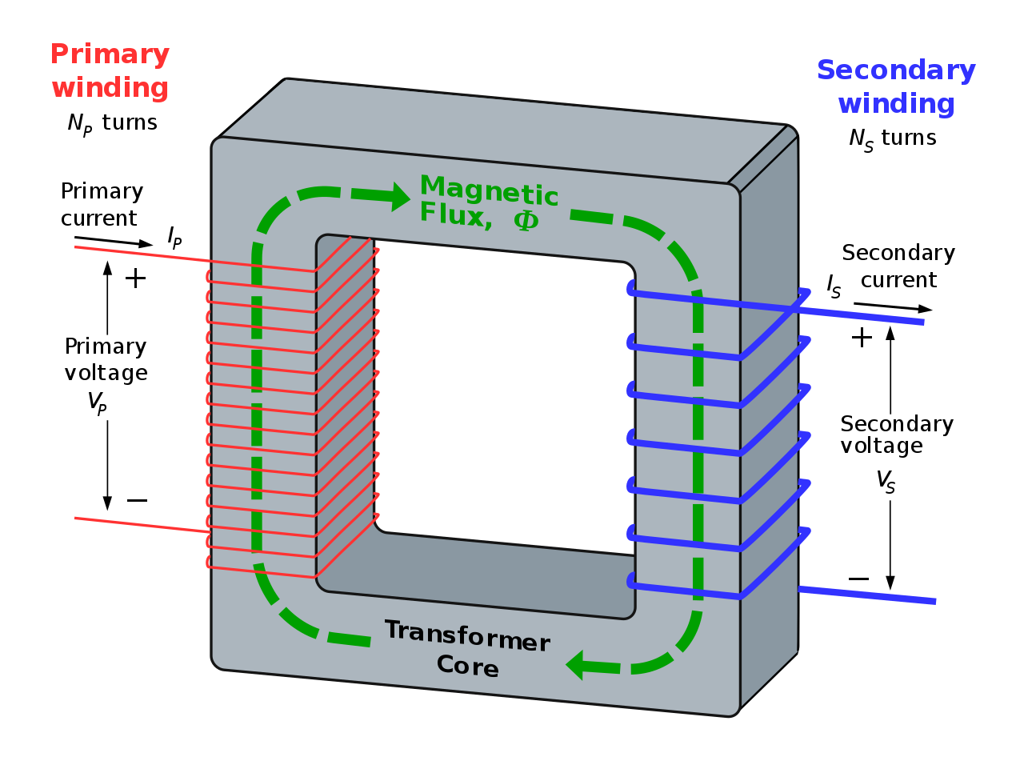
INTRODUCTION OF TRANSFORMER
A transformer is a four-terminal device that transforms an AC input voltage into a higher or lower AC output voltage. It transforms power from a particular circuit to another with no frequency changes regardless of the voltage levels.

Slide 4

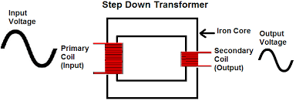
TYPES OF TRANFORMER
STEP UP TRANSFORMER :
Step-up transformer is a transformer that increases the voltage from the primary coil to the secondary coil while managing the same power at the rated frequency in both coils. It converts low voltage & high current from the primary side to the high voltage & low current on the secondary side of the transformer.
STEP DOWN TRANSFORMER :
The Step-down transformer diagram is shown below. For example, the range of voltage used by the power circuit is 230v to 110v, but in electrical devices, it is less like 16v. So to overcome this voltage issue, a step-down transformer is used so that it can be reduced from 230v to 110V and finally to 16v.

Slide 5
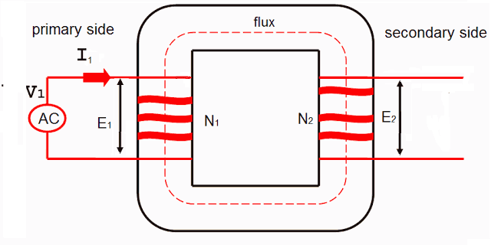
PRINCIPLE OF TRANSFORMER
The transformer works on the principle of Faraday's law of electromagnetic induction and mutual induction. There are usually two coils primary coil and secondary coil on the transformer core. The core laminations are joined in the form of strips. The two coils have high mutual inductance. A transformer works on the principles of "electromagnetic induction" as a mutual induction. Mutual induction is the process by which a coil of wire magnetically induces a voltage in another closely located coil.

Slide 6
ADVANTAGES OF TRANSFORMER
Stepping up / down voltage and current. ...
Isolation and efficiency. ...
Transmitting and distributing power. ...
Cost efficiency. ...
Various types and wide usage areas. ...
No moving parts and starting time. ...
Reverse connected.
More items...

Slide 7
DISADVANTAGES OF TRANSFORMER
A transformer will not work with DC voltage under any condition.
The transformer size become un widely.
The physical size of the transformer is directly related to the amount of power to be desired.
It is not good to use outdoors.
It can be noisy.

Slide 8
CHARACTERITICS OF TRANSFORMER
The input and output power has the same frequency.
All transformers work on the principle of electromagnetic induction.
The primary and secondary coil are not connected. ...
The loss in a transformer is much smaller compared to other devices.

Slide 9
APPLICATIONS OF TRANSFORMER
Alternating Current Regulation. ...
Charging Batteries. ...
Steel Manufacturing. ...
Electrolysis. ...
Controlling the flow of Electricity through a circuit. ...
Audio Transformer. ...
Coolant. ...
Ammeters or Current Transformers.

Slide 10


